Slide 1

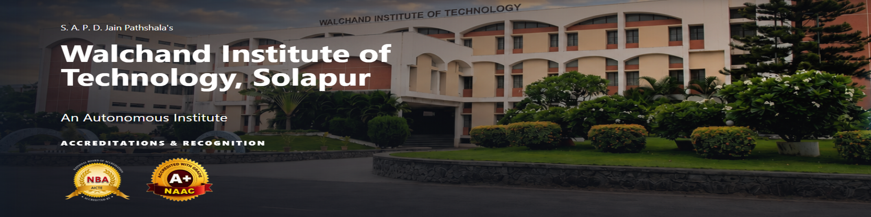
Department of Information Technology
WIT, Solapur
PROJECT SYNOPSIS PRESENTATION
“FutureVerse: A Machine Learning-Based Frame”
GROUP NO:
GUIDE :

Slide 2
Department of Information Technology
WIT, Solapur
“TITLE OF PROJECT”
TEAM DETAILS
Name Of The Student | Roll No.
1.
2.
3.
4.

Slide 3
1. Project overview
Enter text here

Slide 4
Department of Information Technology
FutureVerse
A Machine Learning-Based Framework for Sugarcane Growth Prediction
and Intelligent Farming Recommendations
PROBLEM STATEMENT
PROPOSED SOLUTION
Sugarcane growth and yield are influenced by multiple factors such as soil pH, nutrient levels, temperature, humidity, rainfall, irrigation and crop age. These factors can vary across fields and directly affect crop development and productivity. Farmers may not have a simple data-driven system to analyze these conditions together, predict expected crop performance and identify the most important actions at the right time. This creates a need for an easy-to-use system that can support informed farming decisions.
FutureVerse addresses this problem by using machine learning to analyze soil, weather, irrigation and crop-related parameters and predict sugarcane growth percentage and estimated yield in tons per hectare. The system then converts the prediction and field conditions into practical recommendations for irrigation, fertilizer management, crop management and soil improvement. The results are presented through a simple, farmer-friendly web dashboard so that technical ML information is transformed into clear and actionable farming guidance.
TEAM MEMBERS
GUIDE
Abhishek Danole – A-21
Harsh Abad – A-01
Paras Danole – A-22
Ms. V.V. Manglaram
Assistant Professor
GROUP NO: A-18

Slide 5
2. PROBLEM STATEMENT
Enter text here

Slide 6
3. OBJECTIVES
Enter text here

Slide 7
LITERATURE SURVEY
Enter text here

Slide 8
4. PROPOSED ARCHITECTURE & METHODOLOGY
Enter text here

Slide 9
5. HARDWARE & SOFTWARE REQUIREMENTS
Enter text here

Slide 10
6. EXPECTED DELIVERABLES
Enter text here

Slide 11
7. REFERENCES
Enter text here

Slide 12
QUESTIONS

Slide 13
THANK YOU !

